Slide 1
Visitor Pattern
Andrew Crisler, Riley Jensen, Elisha Hamp

Slide 2
What is it?
It is a Visitor Pattern is a behavioral pattern.
“Element” classes call “Visitor” classes, and in doing so the visitors build on the elements’ behavior by implementing the desired new behavior.
This pattern allows you to implement new behaviors for a class (element) without having to change the code inside the class (element).
This helps make your objects open/closed, if you would like to add a new class of methods and variables you can.
New behavior for the element is defined in the visitor class.

Slide 3
The Future of Amazon: Deforestation
To show of the strength of the visitor pattern we created a virtual distribution platform.
The virtual distribution platform shows users the discounts, shipping time & cost, and how the product is handle.
Each type of user will get different discounts, shipping times & costs, and product handling.

Slide 4
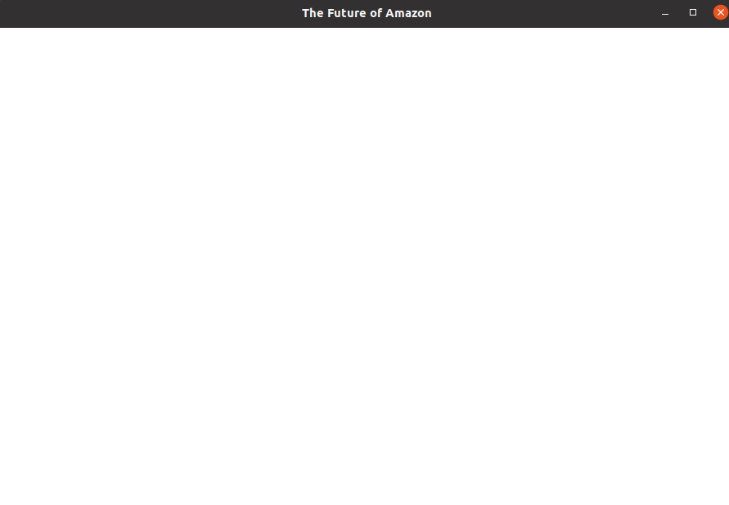
Code Demo
Code Demo will be at this point in the presentation
Current State of the Project

Slide 5
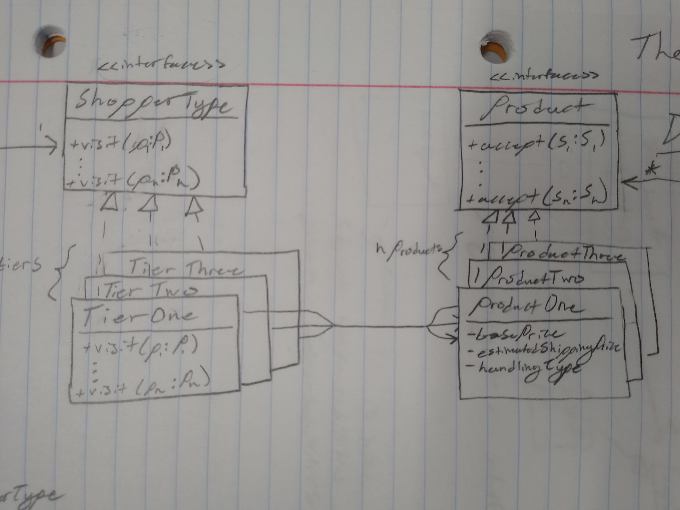
UML here
Domain UML elements.
Tiers are the Visitors
Products are the elements
Each user implements visits differently according to the desired behavior.
Current Sketch of UML, will make more official later

Slide 6
Deep Dive into the Visitor Pattern Structure
When a class “visits” an element, it will call the accept method that all elements must implement and pass in the visitor as a parameter.
This accept method in the element will call their visit method on the visitor passed.
The visitor then implements the new behavior for the element class in the visit method.
The visitor will have a visit method for each element

Slide 7
Why the Visitor Pattern is Great
The visitor pattern allows each user type to implement different behaviors for each element.
The strength of this pattern is that no new behavior is defined in the element class.
This makes the element class open/close
All the element class needs to do is implement the accept method inherited from the interface.

Slide 8
Why the Visitor Pattern Is Not The Greatest
All Visitor methods must be updated when a new Element class is added
Code is less legible due to the Element objects’ code being spread out among the Visitor objects

Slide 9
Key Takeaway
The visitor pattern allows you to change aspects of an element without changing the element itself, keeping the open closed principle with those elements.

